Slide 1
For Live Session Assignment (FLS)
Unit 11

Slide 2
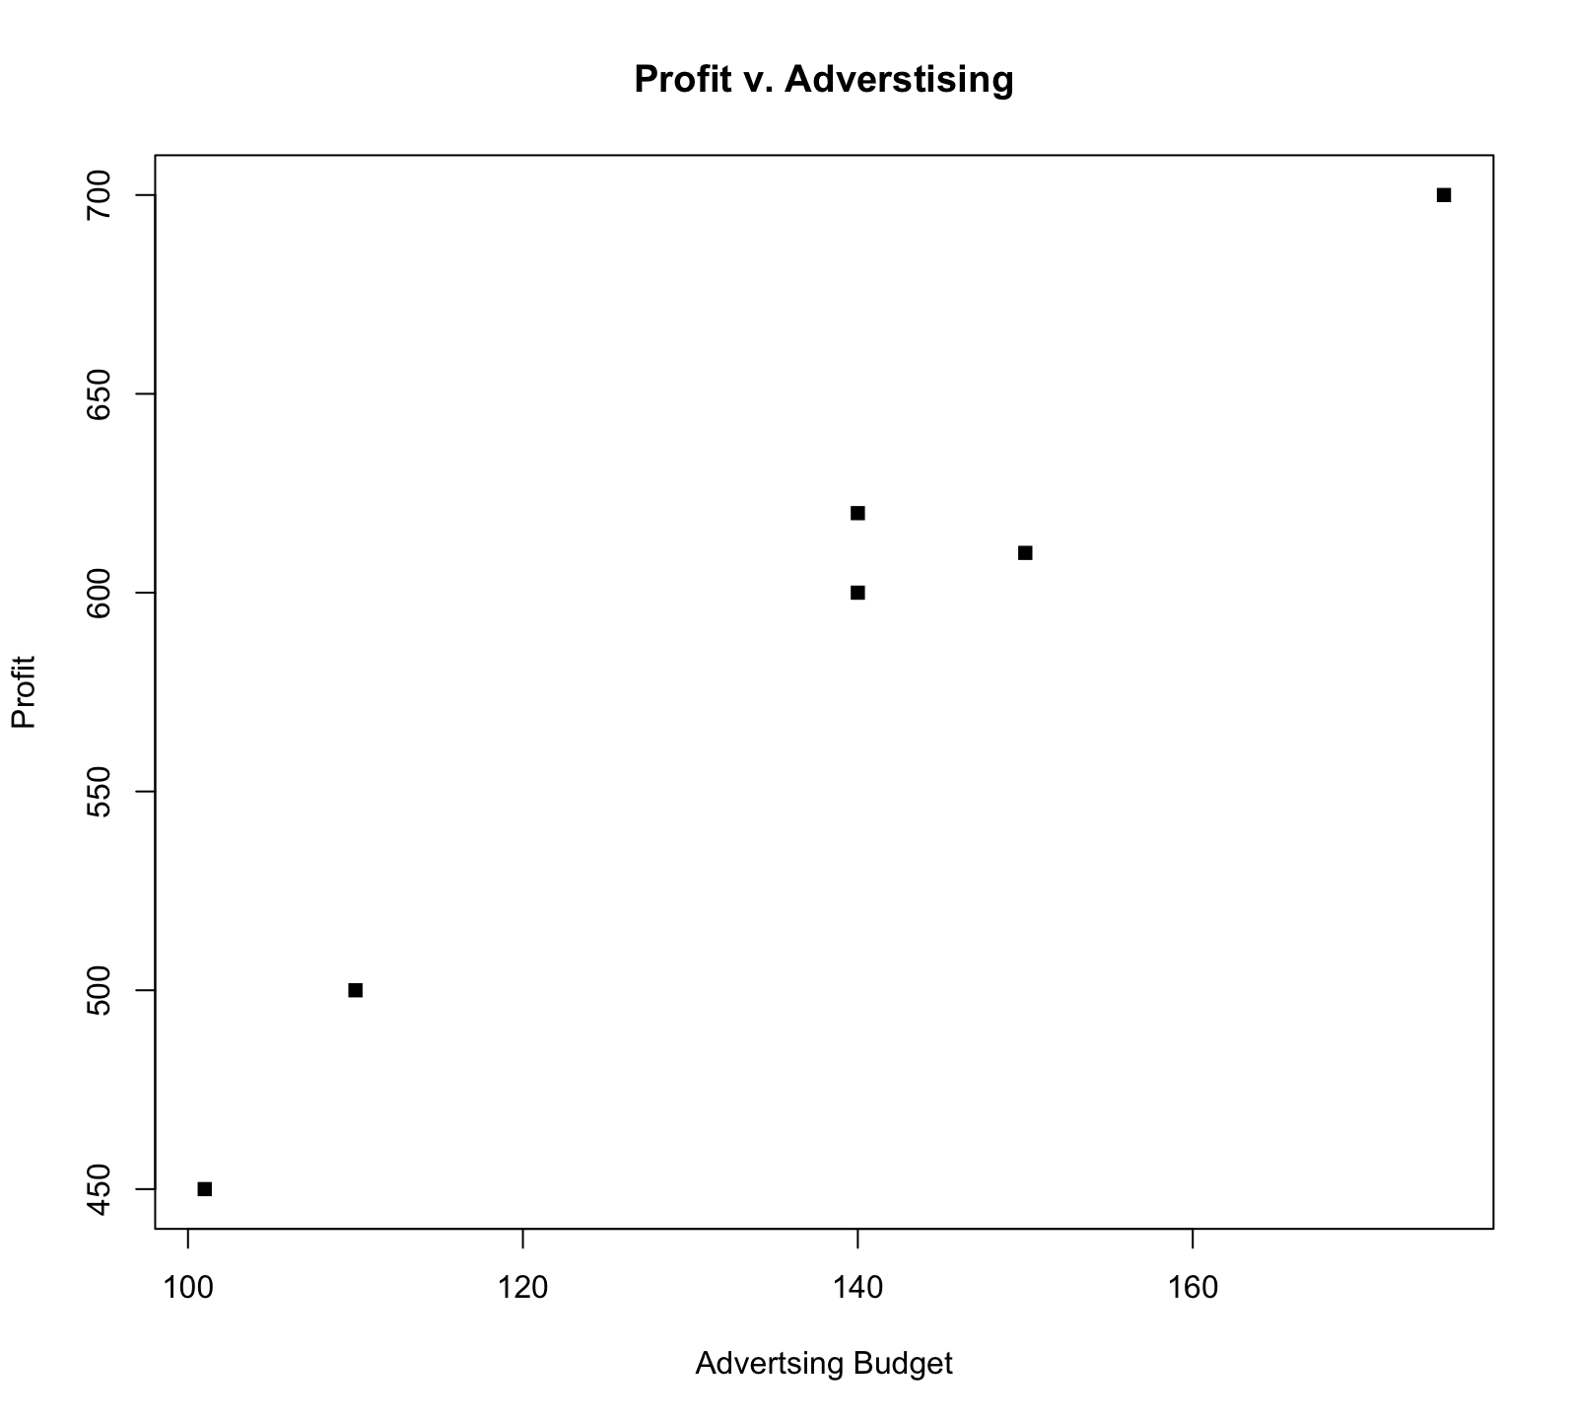
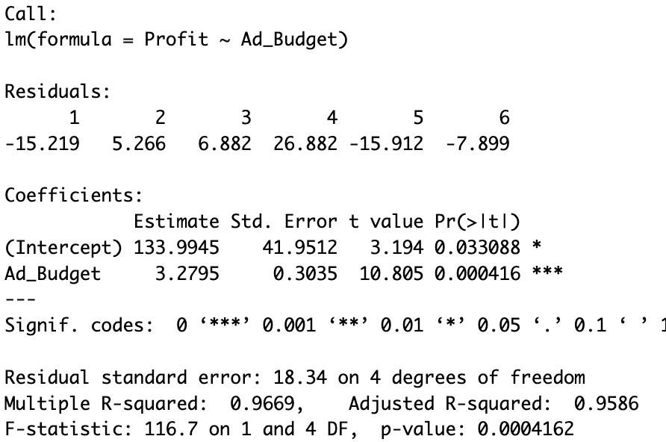
Break out! Right off the bat … read this from a client point of view…
A company hired you to estimate the relationship between their profit and their advertising expenditures. They give you a few years of the profit and advertising budget for that year with a plot of the data below along with the regression line. Read the interpretation of the slope from the client point of view. Is this correct? What could be the possible take away from the client?
Ad_Budget = c(101,110,140, 140, 150, 175)
Profit = c(450, 500, 600, 620, 610, 700)
fit = lm(Profit~Ad_Budget)
summary(fit)
For each $1000 increase in the advertising budget, the Profit will increase by $3,279.50.
plot(Ad_Budget,Profit, pch = 15, ylab = "Profit", xlab = "Advertsing Budget", main = "Profit v. Advertising")

Slide 3
Break out! Right off the bat … read this from a client point of view…
A company hired you to estimate the relationship between their profit and their advertising expenditures. They give you a few years of the profit and advertising budget for that year with a plot of the data below along with the regression line. Read the interpretation of the slope from the client point of view. Is this correct? What could be the possible take away from the client?
Ad_Budget = c(101,110,140, 140, 150, 175)
Profit = c(450, 500, 600, 620, 610, 700)
fit = lm(Profit~Ad_Budget)
summary(fit)
For each $1000 increase in the advertising budget, the Profit will increase by $3,279.50.
The evidence suggests that each $1000 increase in the advertising budget is associated with a $3279.50 increase in the mean (or “predicted” or “expected”) Profit.
plot(Ad_Budget,Profit, pch = 15, ylab = "Profit", xlab = "Advertsing Budget", main = "Profit v. Advertising")

Slide 4
Quick Quiz Questions

Slide 5
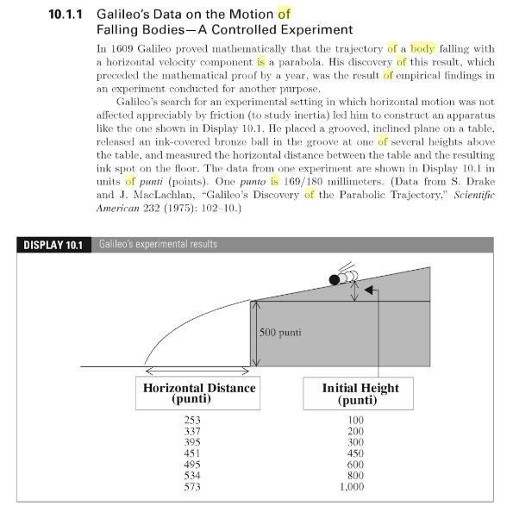
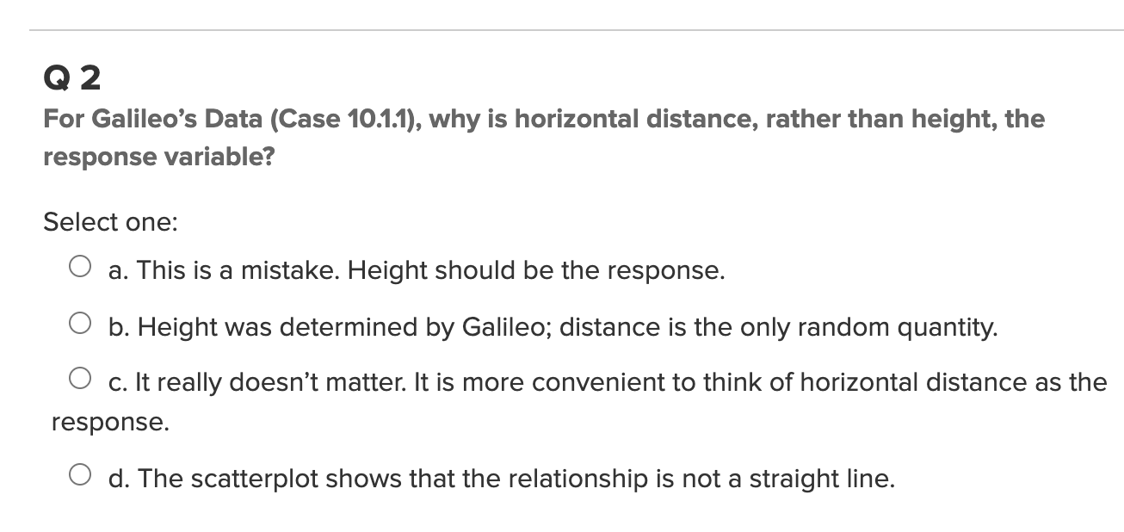
Part 1: Quick Quiz Questions

Slide 6
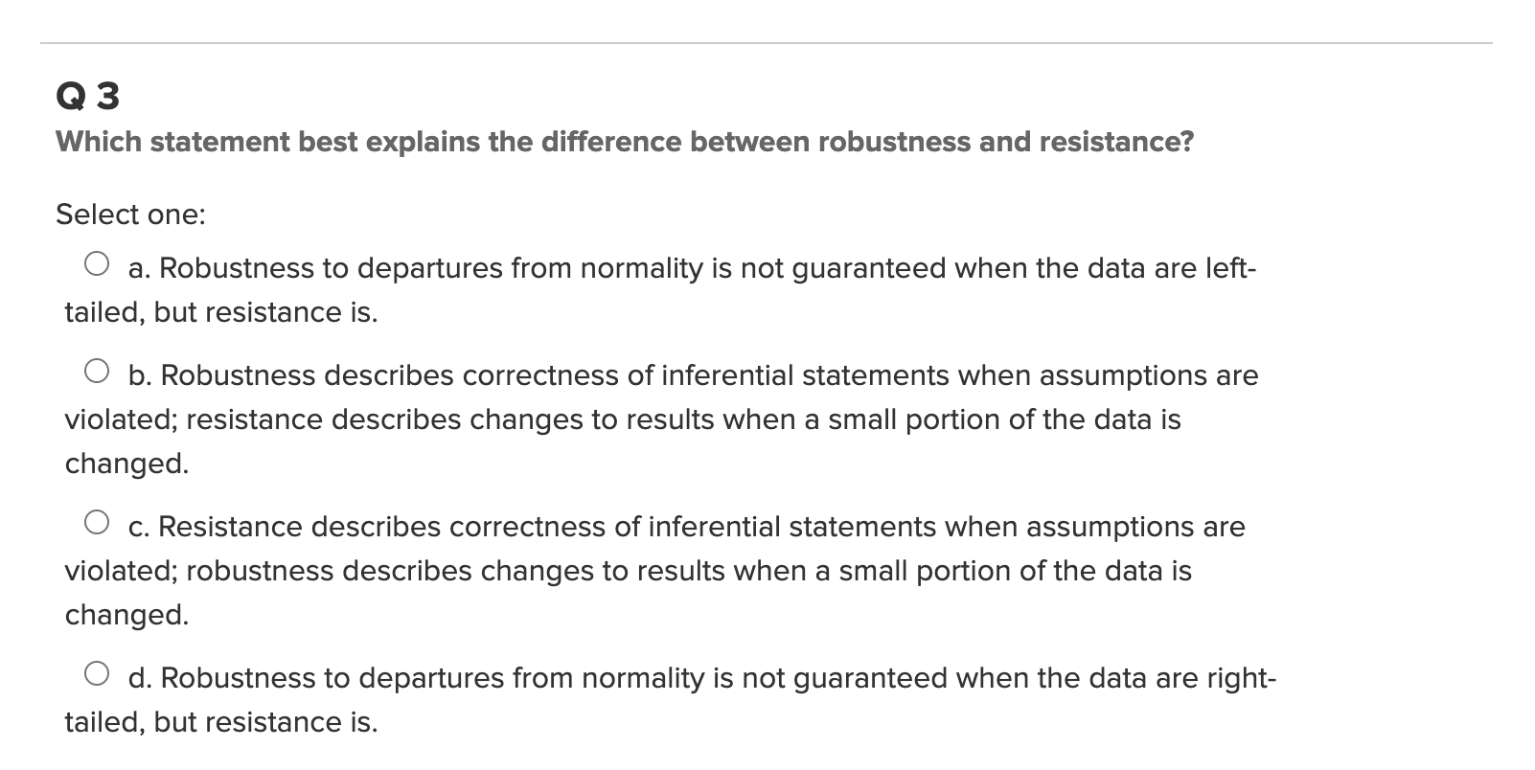
Part 1: Quick Quiz Questions
Review: Blast from the past!

Slide 7
End Quick Quiz Questions

Slide 8


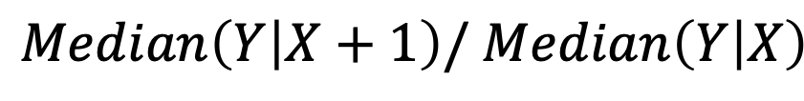
Log Transforms: Log-Linear
$$Median\left(Y | X+1\right)/ Median\left(Y | X\right)$$
$${=e}^{β_{1}}$$
Interpretation: A one unit increase in X is associated with a multiplicative change of $e^{β_{1}}$ in Median(Y|X).
** Note: We use a base of e for $e^{β_{1}}$ because the base on the log function was implied to be e. (Other bases could be interchanged.)

Slide 9
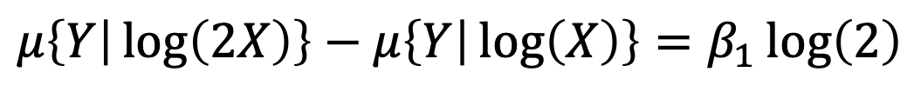

Log Transforms: Linear-Log (cont.)
$$μ\left\{Y | \log\left(2X\right)\right\}−μ\left\{Y | \log\left(X\right)\right\}=β_{1}\log\left(2\right)$$
Interpretation: A doubling of X is associated with a $β_{1}l$og(2) unit change in the mean of Y.

Slide 10
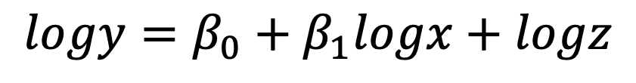
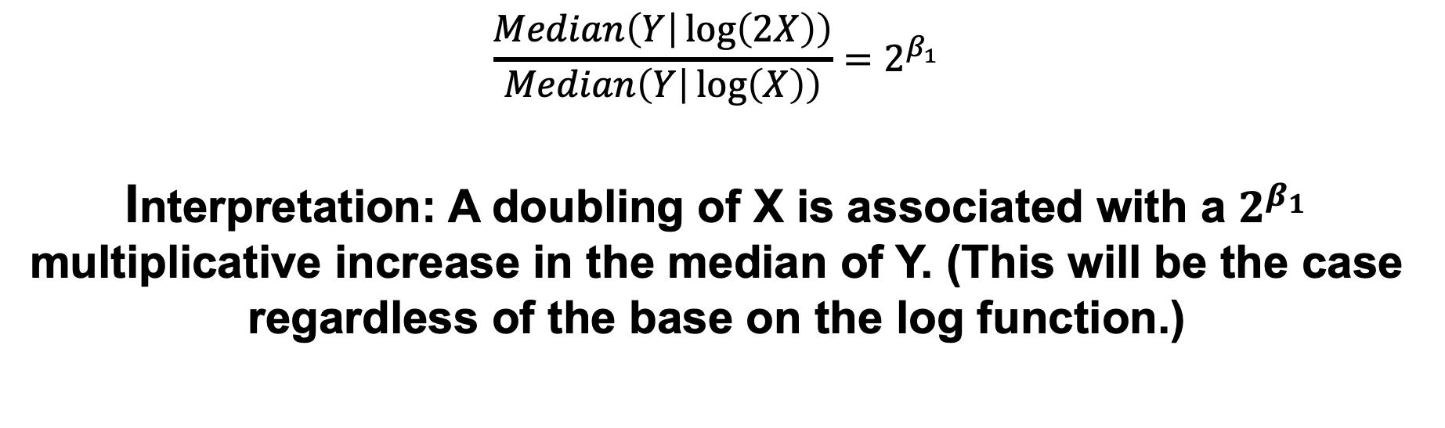
Interpretation Log-Log Model
$$logy=β_{0}+β_{1}logx+logz$$
$$\frac{Median\left(Y | \log\left(2X\right)\right)}{Median\left(Y | \log\left(X\right)\right)}=2^{β_{1}}$$
Interpretation: A doubling of X is associated with a $2^{β_{1}}$ multiplicative increase in the median of Y. (This will be the case regardless of the base on the log function.)

Slide 11
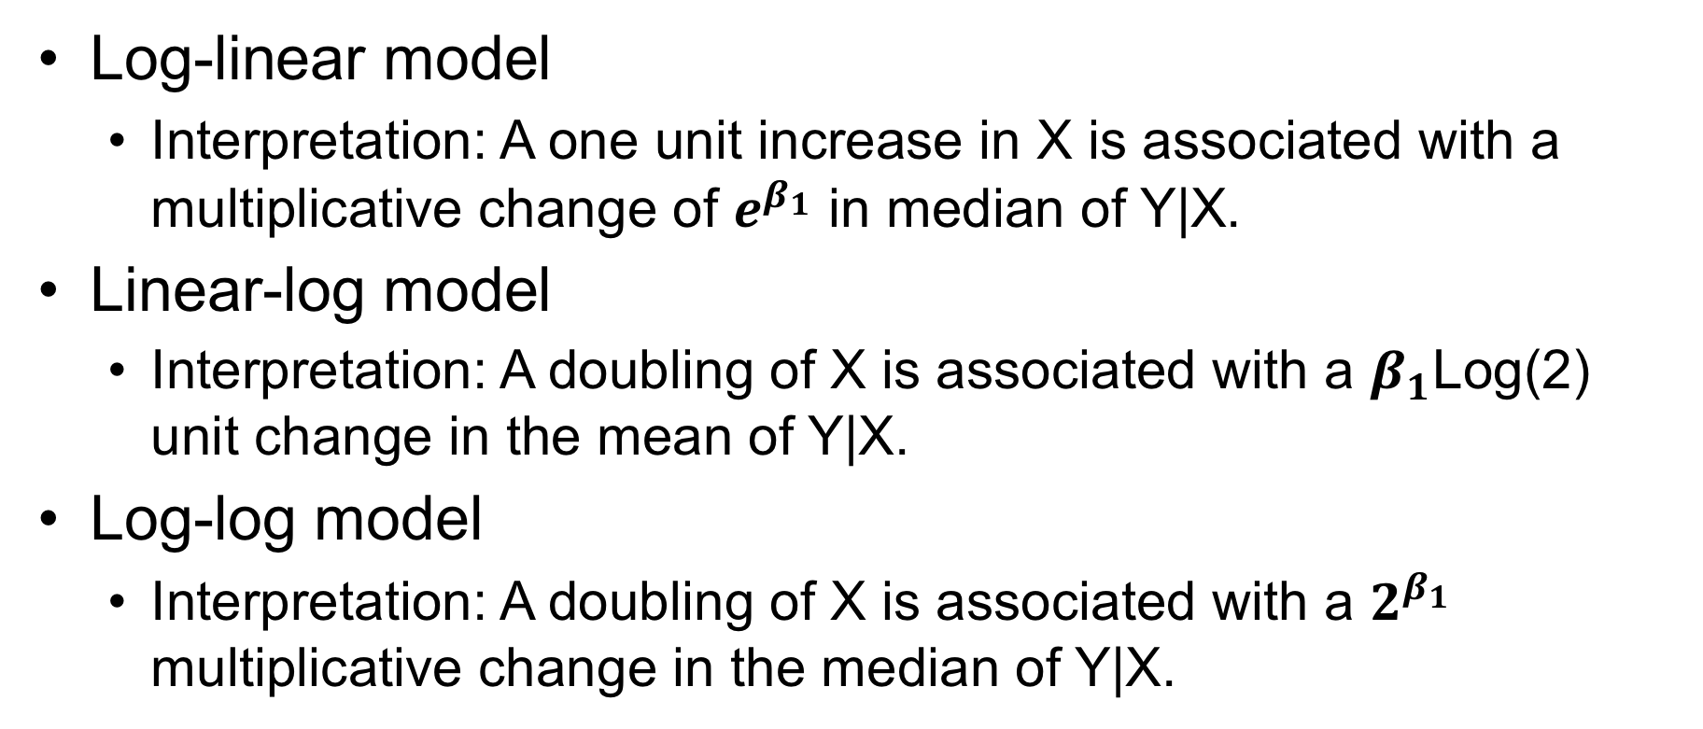
Summary
Log-linear model
Interpretation: A one unit increase in X is associated with a multiplicative change of $e^{β_{1}}$ in median of Y|X.
Linear-log model
Interpretation: A doubling of X is associated with a $β_{1}$Log(2) unit change in the mean of Y|X.
Log-log model
Interpretation: A doubling of X is associated with a $2^{β_{1}}$ multiplicative change in the median of Y|X.

Slide 12
Question 1

Slide 13
Infant Mortality versus GDP
A hugely impactful issue around the world is that of the infant mortality rate.
We would like to conduct a study of infant mortality versus GDP.
Turns out the World Bank keeps this data … and … as you know (or will know after DDS)… they have an API available through R! (package WDI).
I have provided the code (on the next slide), but please dissect the code to pick up and/or polish a data ingestion and wrangling skill!
Use the resulting dataset to plot Infant mortality rate (Y) versus GDP (X).
Does it look like there is a linear relationship?
If there does not appear to be a linear relationship, research if a log transform of one or both variables will be helpful in conducting a linear regression.
If you were able to find a reasonable transformation, fit a simple linear regression line to the data and show the plot.
Find the GDP of the United States of America and report if the actual infant mortality rate is above or below the amount expected by the regression line. This line can be interpreted as the average Infant mortality rate after adjusting for GDP (you might hear it in the news reported in this fashion.)
Finally, we would like to try and quantify the relationship between Infant Mortality and GDP. Interpret the slope of the regression line on the original scale (not on the log scale).
Be sure to quantify the uncertainty by including a confidence interval.
The code is on the next slide! Have fun!

Slide 14
OLD: Infant Mortality versus GDP: R Code
What is the problem?
install.packages(“WDI”)
library(tidyverse)
library(WDI)
WDIsearch("infant") # yields the indicator: SP.DYN.IMRT.IN
WDIsearch("GDP") # yields the indicator: NY.GDP.PCAP.CD
InfantMort = WDI(,"SP.DYN.IMRT.IN",start = 2019, end = 2019)
GDPs = WDI(,"NY.GDP.PCAP.CD",start = 2019, end = 2019)
InfantVGDP = inner_join(GDPs,InfantMort,"country")
InfantVGDP = InfantVGDP[,c(1,2,3,4,6)]
colnames(InfantVGDP) = c("iso2C","country","GDP","year","InfantMort")
InfantVGDP

Slide 15
New: Infant Mortality versus GDP: R Code
What is the fix?
install.packages("WDI")
library(WDI)
WDIsearch("infant") # yields the indicator: SP.DYN.IMRT.IN
WDIsearch("GDP") # yields the indicator: NY.GDP.PCAP.CD
InfantMort = WDI(,"SP.DYN.IMRT.IN",start = 2019, end = 2019)
GDPs = WDI(,"NY.GDP.PCAP.CD",start = 2019, end = 2019)
InfantVGDP = inner_join(GDPs,InfantMort, "country")
InfantVGDP = InfantVGDP %>% select("country","NY.GDP.PCAP.CD","SP.DYN.IMRT.IN")
colnames(InfantVGDP) = c("country","GDP","InfantMort")
InfantVGDP

Slide 16
Infant Mortality versus GDP
Use the resulting dataset to plot Infant mortality rate (Y) versus GDP (X).
Does it look like there is a linear relationship?
InfantVGDP %>% ggplot(aes(x = GDP, y = InfantMort)) + geom_point() + ggtitle("Infant Mortality versus GDP")

Slide 17
Infant Mortality versus GDP
If there does not appear to be a linear relationship, research if a log transform of one or both variables will be helpful in conducting a linear regression.
InfantVGDP %>%
ggplot(aes(x = log(GDP), y = InfantMort) +
geom_point() +
ggtitle("Infant Mortality versus log(GDP"))
InfantVGDP %>%
ggplot(aes(x = GDP, y = log(InfantMort))) +
geom_point() +
ggtitle(”log(Infant Mortality) versus GDP")
InfantVGDP %>%
ggplot(aes(x = log(GDP), y = log(InfantMort))) +
geom_point() +
ggtitle(”log(Infant Mortality) versus log(GDP"))

Slide 18
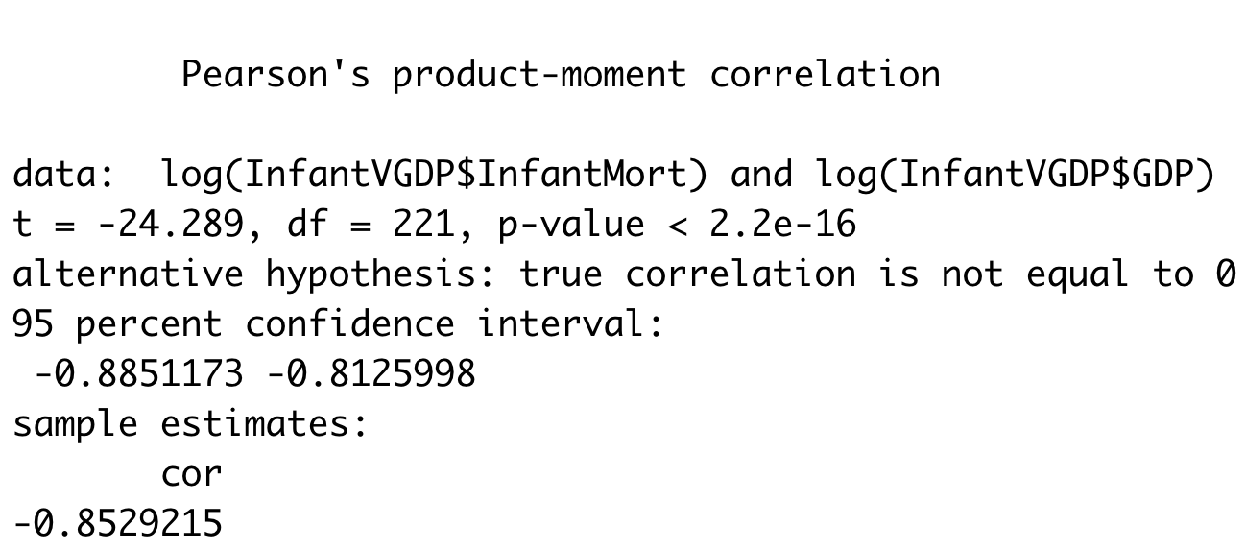
Infant Mortality versus GDP
If there does not appear to be a linear relationship, research if a log transform of one or both variables will be helpful in conducting a linear regression.
cor.test(log(InfantVGDP$InfantMort),log(InfantVGDP$GDP))
For Fun! What do you notice about this result? cor.test(InfantVGDP$InfantMort,InfantVGDP$GDP)

Slide 19
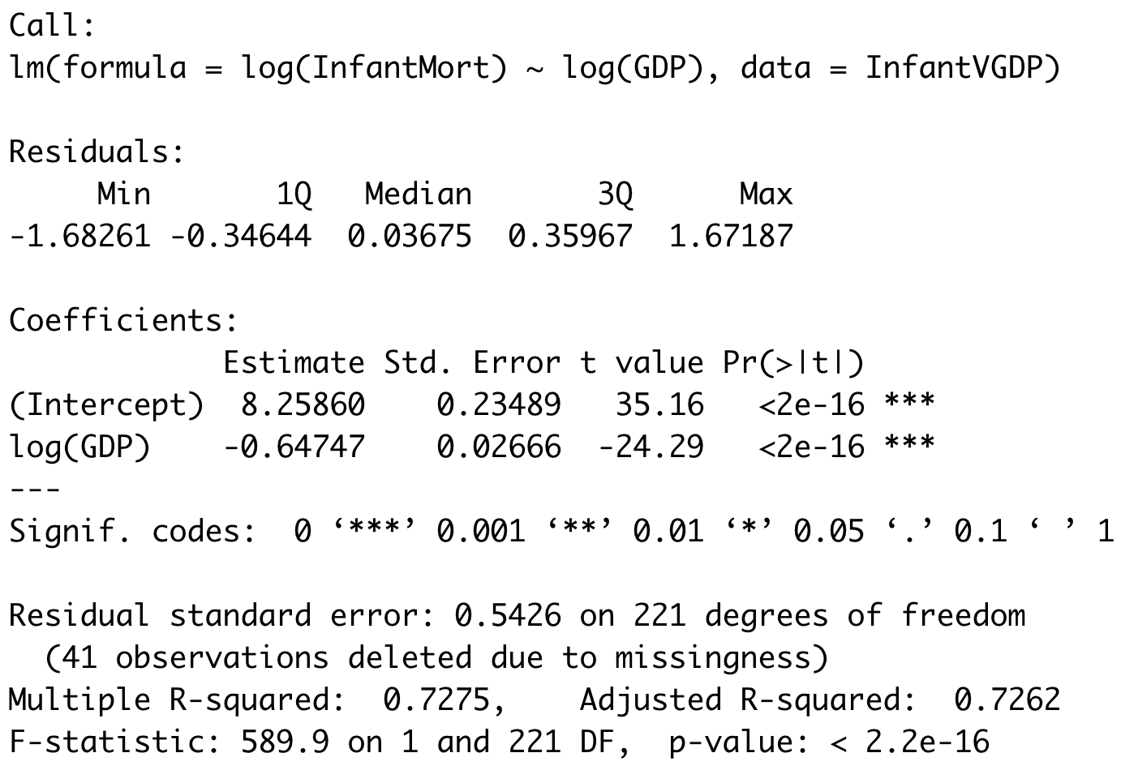
Infant Mortality versus GDP
If you were able to find a reasonable transformation, fit a simple linear regression line to the data and show the plot.
fit = lm(log(InfantMort)~log(GDP), data = InfantVGDP)
summary(fit)
For Fun! What do you notice about this result? fit = lm(InfantMort~GDP, data = InfantVGDP)
summary(fit)

Slide 20
Infant Mortality versus GDP
fitloglog = lm(log(InfantMort)~log(GDP), data = InfantVGDP)
plot(fitloglog)

Slide 21
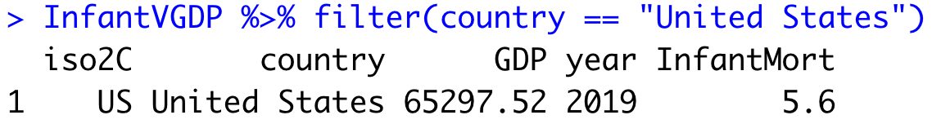
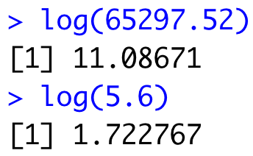
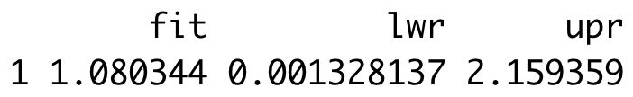
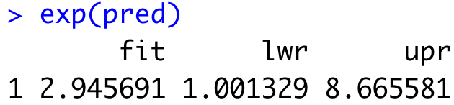
Infant Mortality versus GDP
Find the GDP of the United States of America and report if the actual infant mortality rate is above or below the amount expected by the regression line. This line can be interpreted as the median Infant mortality rate after adjusting for GDP (you might here it in the news reported in this fashion.)
InfantVGDP %>% filter(country == "United States")
fit = lm(log(InfantMort)~log(GDP), data = InfantVGDP)
newdata = data.frame(GDP = 65297.52)
pred = predict(fit,newdata = newdata, interval = "prediction")
pred
The expected infant mortality rate for a country with a GDP similar to that of the US is 2.95% while the actual infant mortality rate in the US is 5.6%.

Slide 22
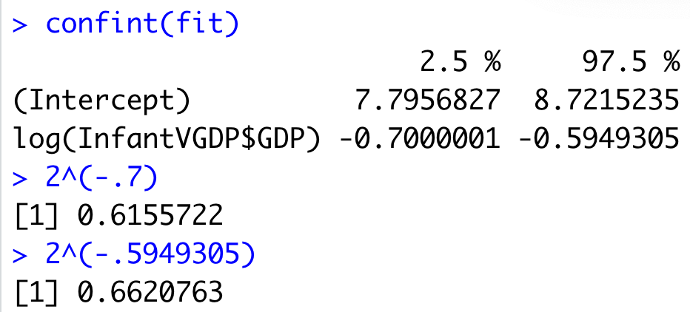
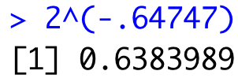
Infant Mortality versus GDP
Finally, we would like to try and quantify the relationship between Infant Mortality and GDP. Interpret the slope of the regression line on the original scale (not on the log scale).
$$log⁡(Infant Mortality)=8.25860 − .64747∗log⁡(GDP)$$
(1 - .638) * 100%
We are 95% confident that for each doubling of the GDP the median infant mortality rate will decrease between approximately 33.8% and 38.5%. Our best estimate is a decrease of 36.2%.

Slide 23
End Question 1

Slide 24
Question 2

Slide 25
Lack of Fit Test
A company wants to look at sales volume (in $M) for various stores for three different months. Perform a lack of fit test (at significance level 0.05) to determine if the separate means model (using three parameters) is significantly better than the linear regression model (using two parameters).
You may want to copy the blank ANOVA table on paper.
DO NOT plug the data into any software. ☺
Month | Sales
1 | 2.678969
1 | 6.452194
1 | 1.837394
1 | 6.108601
1 | 5.369281
2 | 1.766862
2 | 6.898837
2 | 1.579677
2 | 3.726494
2 | 8.953184
3 | 8.680436
3 | 9.931636
3 | 6.691443
3 | 11.39723
3 | 14.93447
Source | df | SS | MS | F | Pr > F

Slide 26
Lack of Fit Test
A company wants to look at sales volume (in $M) for various stores for three different months. Perform a lack of fit test (at significance level 0.05) to determine if the separate means model (using three parameters) is significantly better than the linear regression model (using two parameters).
You may want to copy the blank ANOVA table on paper.
DO NOT plug the data into any software.
H_{o}: Linear Regression Model Has Good Fit (No lack of fit.)
H_{a}: The separate means model fits better (Linear Regression Model is Lacking Fit.)
Month | Sales
1 | 2.678969
1 | 6.452194
1 | 1.837394
1 | 6.108601
1 | 5.369281
2 | 1.766862
2 | 6.898837
2 | 1.579677
2 | 3.726494
2 | 8.953184
3 | 8.680436
3 | 9.931636
3 | 6.691443
3 | 11.39723
3 | 14.93447
Source | df | SS | MS | F | Pr > F
^{Model (Difference)} | 1 | 26.5 | 26.5/1=26.5 | 3.24
_{Error (ANOVA)} | 12 | 98.2 | 8.18
_{Total (Regression)} | 13 | 124.7 | 9.59
Source | df | SS | MS | F | Pr > F
_{Total (Regression)} | 13 | 124.7
Source | df | SS | MS | F | Pr > F
^{Model (Difference)} | 1 | 26.5 | 26.5/1=26.5
_{Error (ANOVA)} | 12 | 98.2 | 8.18
_{Total (Regression)} | 13 | 124.7 | 9.59
Source | df | SS | MS | F | Pr > F
_{Error (ANOVA)} | 12 | 98.2 | 8.18
_{Total (Regression)} | 13 | 124.7 | 9.59
Source | df | SS | MS | F | Pr > F
^{Model (Difference)} | 1 | 26.5
_{Error (ANOVA)} | 12 | 98.2 | 8.18
_{Total (Regression)} | 13 | 124.7 | 9.59
Source | df | SS | MS | F | Pr > F
^{Model (Difference)} | 1 | 26.5 | 26.5/1=26.5 | 3.24 | 0.10
_{Error (ANOVA)} | 12 | 98.2 | 8.18
_{Total (Regression)} | 13 | 124.7 | 9.59
Source | df | SS | MS | F | Pr > F
At significance level alpha = 0.05, there is insufficient evidence that the separate means model is a significantly better fit than the linear regression model (p-value = 0.10).There is not enough evidence to suggest lack of fit of the regression model.

Slide 27
End Question 2

Slide 28
Question 2: Takeaways!
Please provide at least 4 takeaways from this section and any questions that you may have. These questions will help design the live session for this unit.
This question will be the last question of every For Live Session Assignment. The idea is that this deck will serve as a document that you can reference in the future to remember what was covered in this section. For instance, this may come in handy for the Capstone and will hopefully become useful in your career. Most immediately, it may become handy as a quick reference for your Midterm and Final! Some students find it very useful and spend a few slides summarizing the asynch material while others learn different ways and only had the minimum 4 takeaways. Either is fine and will earn you full credit for this question.

Slide 29
Question 3: Questions!
Please provide any question or topics of discussion that came up in this Unit! These will help help us optimize our live session for maximum learning and takeaways!
This question will be the last question of every For Live Session Assignment. The idea is that this deck will serve as a document that you can reference in the future to remember what was covered in this section. For instance, this may come in handy for the Capstone and will hopefully become useful in your career. Most immediately, it may become handy as a quick reference for your Midterm and Final! Some students find it very useful and spend a few slides summarizing the asynch material while others learn different ways and only had the minimum 4 takeaways. Either is fine and will earn you full credit for this question.

Slide 30
End For Live Session Assignment Unit 11!

